Slide 1

DSA
Module Briefing
Data Structures and Algorithms (DSA)
Diploma in ISF, IT, FI
Year 2 (2018/19), Semester 4
Notes:
Dip ISF – core
Dip IT, FI – optional elective

Slide 2
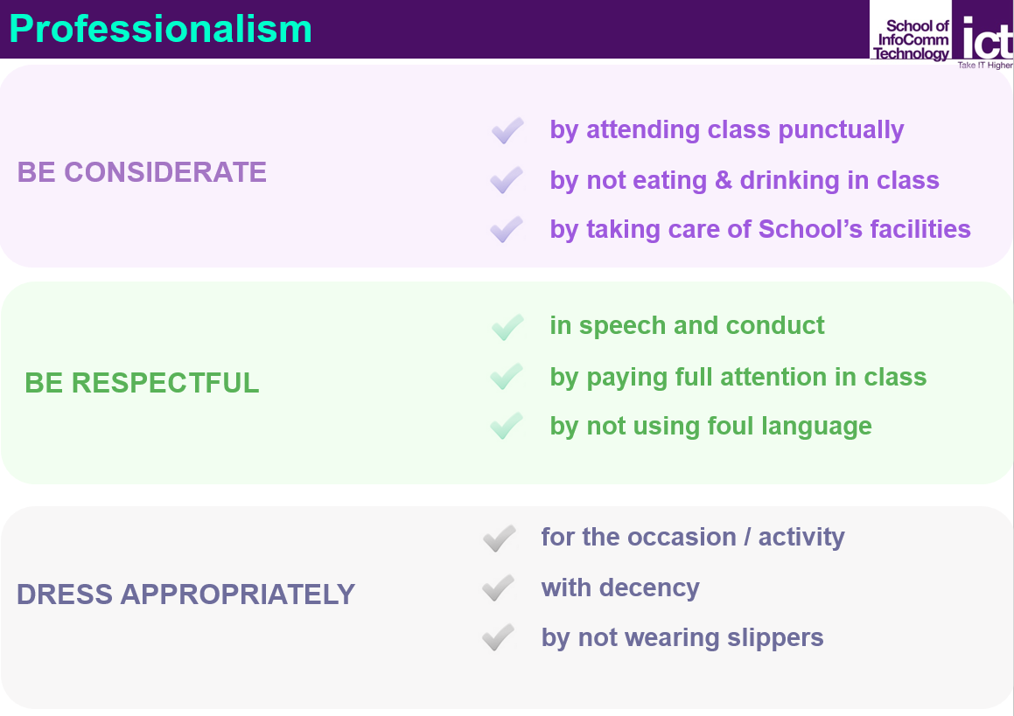
Professionalism@ICT

Slide 3
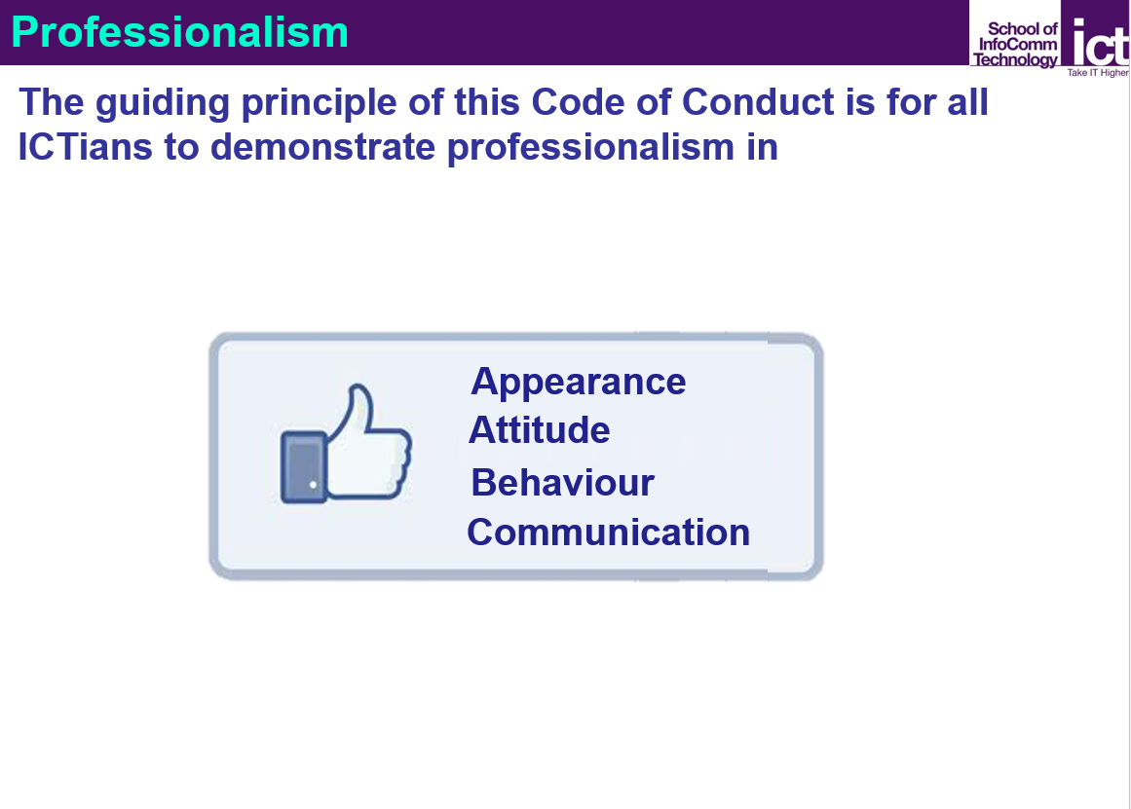
Professionalism@ICT

Slide 4

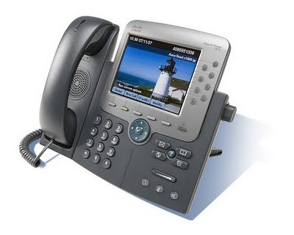
Teaching Team
Dr OON Wee Chong (Module Leader)
Email: owc2@np.edu.sg
Work Phone: 6460 6854
Dr Pamela LOY
Email: lsm@np.edu.sg
Work Phone: 6460 6722
Mr LIM Poh Seng
Email: lps@np.edu.sg
Work Phone: 6460 6886
Mr Ravi John CAMPBELL
Email: crj2@np.edu.sg
Work Phone: 6460 6833

Slide 5
What you will be learning …
Upon successful completion of this module, you should be able to:
select and construct appropriate data structures to represent the data inherent in the problem domain
analyse suitable algorithms based on the data structures
Teaching Plan
refer to MeL → DSA → Module Information

Slide 6
Teaching Plan
15 Oct 2018 – 24 Feb 2019
Week 1 to 8
Week 9, Dec 2018, (Common Test) ← Do not go for holidays!
TWO weeks break (Dec)
Week 12 to 17
Assignment (weeks 14 - 15)
Examination (weeks 18/19)
Holidays
Week 4, 6 Nov 2018 (Tue), Deepavali
Week 12, 31 Dec - 1 Jan 2018 (Mon/Tue), New Year’s Day
Week 17, 5-6 Feb 2018 (Tue/Wed) Lunar New Year

Slide 7

Assessment
Assessment Type | Weightage
CA (Continuous Assessment) | 20%
CT (Common Test) | 20%
Assignment (Program) | 20%
Examination | 40%
Total | 100%

Slide 8

CA – Continuous Assessment (20%)
Participation in tutorials and practicals (weekly)
“learn from expert” - video segments
“VisuAlgo” – online tool to visualise data structures and algorithms through animation
Work done during practical sessions to be submitted to the DSA network folder

Slide 9
Common Test (20%)
Written test
Conducted in week 9
1.5 hours duration
Closed book
Scope
All topics taught from weeks 1 to 8

Slide 10
Assignment (20%)
To develop an application (team with individual component) according to given problem specification
Weeks 14 to 15
Warning: Additional hours beyond class are expected. You have to start early.

Slide 11
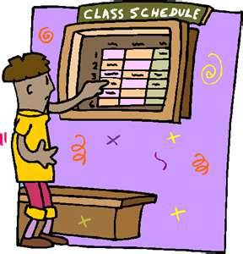
Weekly Schedule
Hours | Activities
1-2 hours | Lecture Tutorial
2-3 hours | Practical Exploration

Slide 12
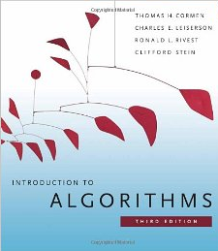
References
Data Structures and Problem Solving with C++ (6th Edition), Frank M. Carrano, Prentice Hall
Introduction to Algorithms (3rd Edition), Thomas H. Cormen, Charles E. Leiserson, Ronald L. Rivest, Clifford Stein, The MIT Press
Useful Online References
http://ocw.mit.edu/courses/electrical-engineering-and-computer-science/6-046j-introduction-to-algorithms-sma-5503-fall-2005/video-lectures/
Please share your online resources with your tutor or classmates.

Slide 13

Resources
Recommended
Visual Studio Professional 2017 https://acustd3.np.edu.sg/caltiris/default.aspx?action=signin
Others
Eclipse C/C++ Development Tooling with MinGW
You can also try in Linux or Ubuntu or Mac OS and work using Eclipse (MinGW installation not required)

Slide 14
Resources
Q & A

